Slide 1
Maximizing Information Technology Value
Diamonds in the dust
Crafting your future landscape
20 May 2009
Dr James A Robertson PrEng
James@JamesARobertson.com
Notes:
NB remember to have a chair to stand on
Make sure to take the CRITICAL FACTORS BOOK with you
An engineer with a PhD in engineering

Slide 2
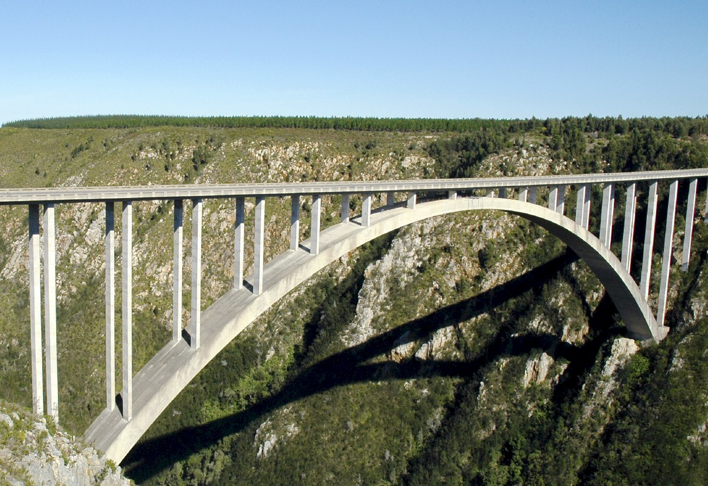
I.T. versus bridges
Notes:
In considering what i have learned as an engineer with considerable experience of the practical application of information technology i eventually realized about ten years ago that
ENGINEERS DO NOT DESIGN BRIDGES TO STAND UP – click

Slide 3
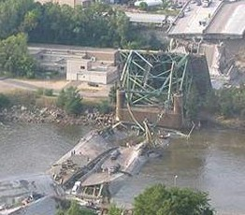
Engineers do NOT design bridges to stand up
Notes:
Who remembers this bridge collapse in Minneapolis in the middle of 2007? Within minutes it was front page news around the world – we do NOT expect bridges to fall down – if we did there would not have been anyone on that bridge that day!

Slide 4
Engineers design bridges NOT to fall down
Notes:
There is a fundamental difference in approach when one designs a bridge NOT TO FALL DOWN
Contrast this with the IT paradigm which could be called “designed to fail”

Slide 5
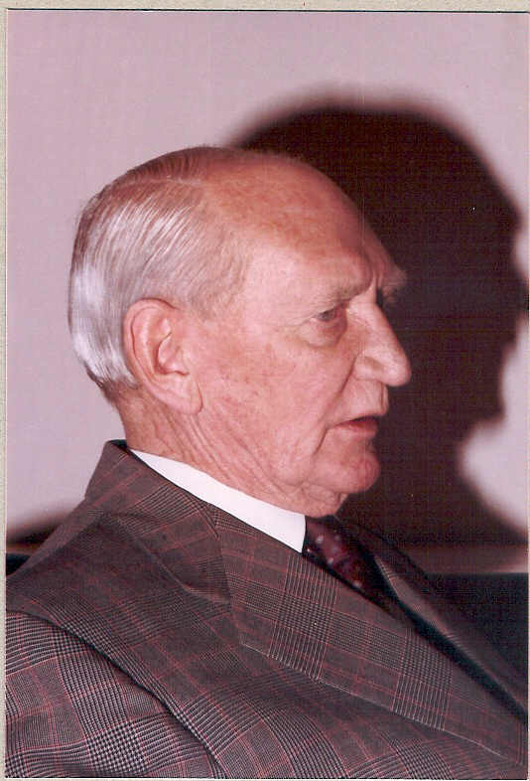
Vision
Angus Struan Robertson
Notes:
KEEP SHORT AND SIMPLE
MY FATHER
How did i get involved with computers? – my father was a visionary -- In 1981, having gathered over 7,000 pages of research data for my PhD the University mainframe did not have space to store even one page of data. My father purchased me one of the first desktop PC’s in the days of the Apple and Apricot and 123, etc – at a cost of R12,000 two and a half times my research grants! – I very quickly discovered that there was a HUGE gap between what the salesman told me the computer could do and getting it to do it – so, in that respect, NOTHING HAS CHANGED ☺ -- I then put myself through a self taught computer science programme and learned to program, learned to type and finally wrote an award winning PhD thesis – at the same time I computerized my father’s investment consulting business and we were able to double turnover in twelve months and create an enduring revenue stream that lasted for over ten years because we were able to do things that much larger businesses were not able to do – it was then that I began to understand that the strategic application of information technology COULD deliver great value and one of my greatest frustrations is the extent to which few businesses achieve this potential – the rest of this presentation is about lessons I have learned that I hope will help YOU to make a difference in your business with IT

Slide 6
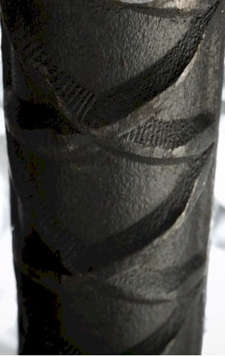
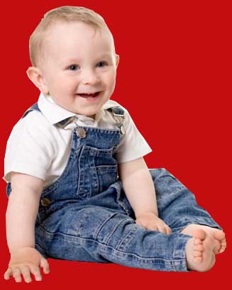
Experiencing failure

Slide 7
Information technology
Notes:
KEEP SHORT AND SIMPLE
MY FATHER
How did i get involved with computers? – my father was a visionary -- In 1981, having gathered over 7,000 pages of research data for my PhD the University mainframe did not have space to store even one page of data. My father purchased me one of the first desktop PC’s in the days of the Apple and Apricot and 123, etc – at a cost of R12,000 two and a half times my research grants! – I very quickly discovered that there was a HUGE gap between what the salesman told me the computer could do and getting it to do it – so, in that respect, NOTHING HAS CHANGED ☺ -- I then put myself through a self taught computer science programme and learned to program, learned to type and finally wrote an award winning PhD thesis – at the same time I computerized my father’s investment consulting business and we were able to double turnover in twelve months and create an enduring revenue stream that lasted for over ten years because we were able to do things that much larger businesses were not able to do – it was then that I began to understand that the strategic application of information technology COULD deliver great value and one of my greatest frustrations is the extent to which few businesses achieve this potential – the rest of this presentation is about lessons I have learned that I hope will help YOU to make a difference in your business with IT

Slide 8
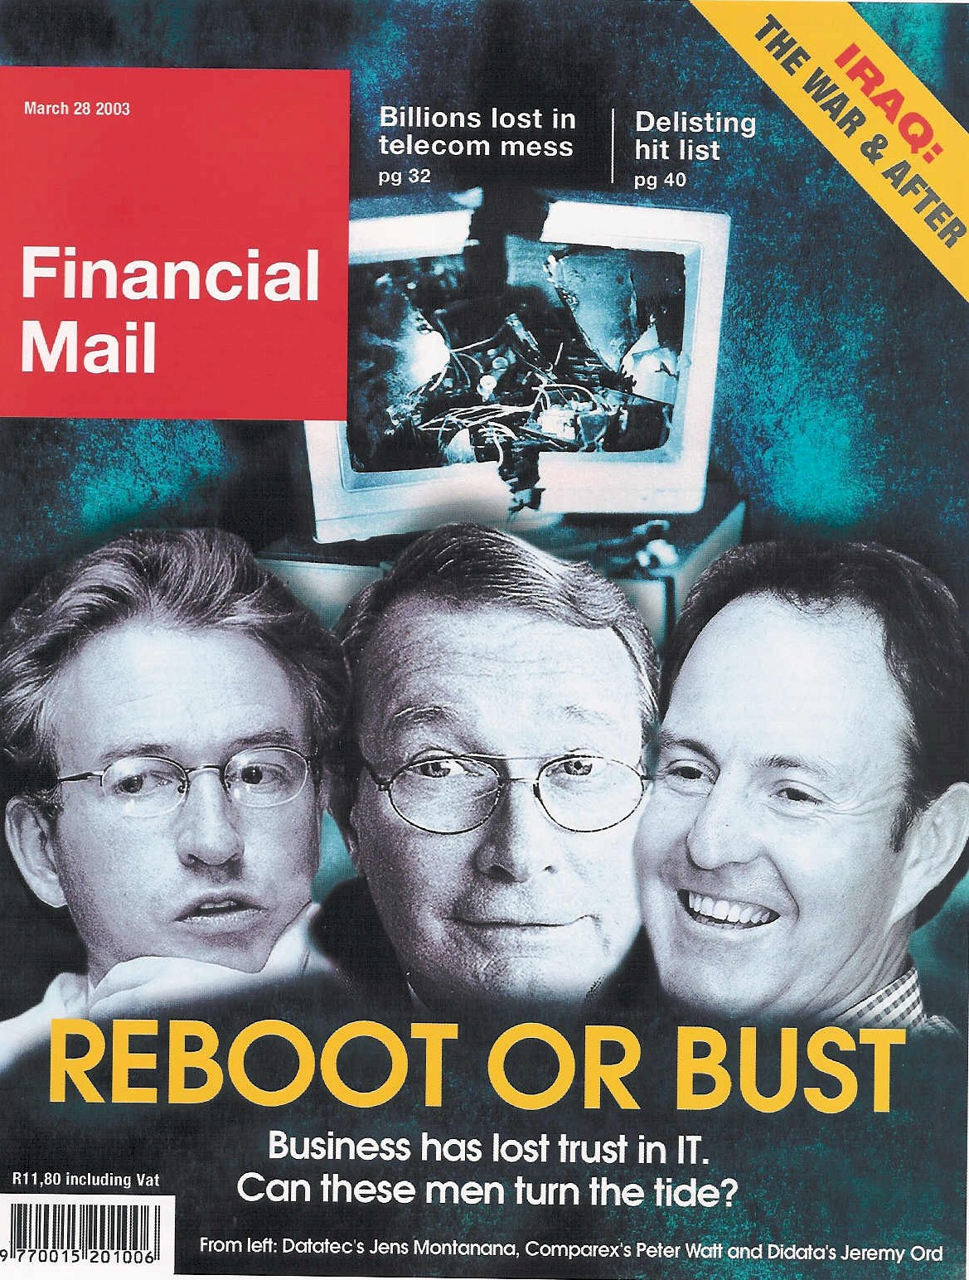
An industry in crisis
“19 out of 20 E.R.P. (business system) Implementations do NOT deliver what was promised”
Notes:
An industry in Crisis -- Quote from Duncan McLeod, Financial Mail, 28 March 2008 -- Seven years and half a billion dollars -- Dow Chemicals Company -- $400 million – Nike -- Disney -- $878 million
-- 70% of business IT projects fail outright – another 20% materially fail to meet the business expectation – 70% of BPR projects fail and 90% of strategic plans fail to deliver

Slide 9
Extreme failures
Seven years and half a billion dollars -- international chemicals company
$400 million -- multinational shoe corporation
Multinational entertainment giant -- $878 million
Major supermarket chain -- $195 million

Slide 10
Business system failure can trash your business
“The next corporate disaster waiting to happen”
Notes:
Professor Richard Nolan states that "I.T. is the next corporate disaster waiting to happen”
And postulates that soon there will be an Enron level corporate failure
Do you remember Fedsure Health – tell the story SHORT

Slide 11
Y2K
Notes:
Do you remember Y2K?
The stories of aircraft to drop out of the sky, cities to be gridlocked, etc?
Did any of it happen?
How long had we known about the year 2,000?
The greatest act of collective incompetence in the history of human kind?
The greatest act of hype and greed?
Something else?

Slide 12
There is a need for a new approach
Notes:
There is a fundamental difference in approach when one designs a bridge NOT TO FALL DOWN

Slide 13
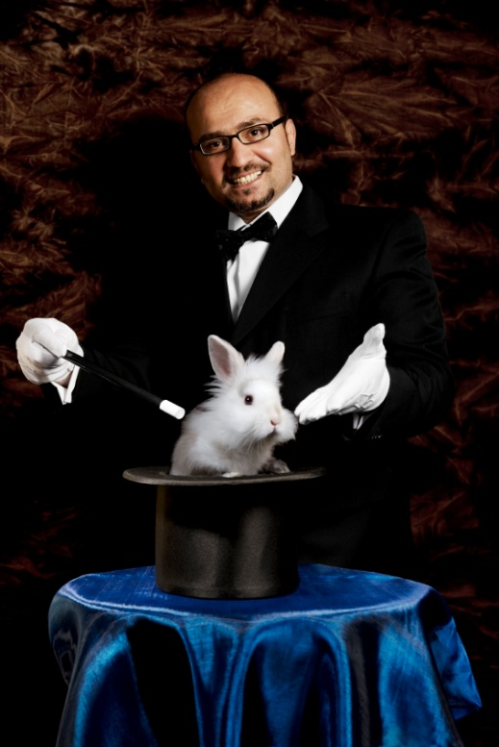
What is NOT an engineering approach?
Notes:
What is not an engineering approach? – Dramatically walk to chair – did this ever happen to you? –
WHEN SLEEPING
when i was a child i used to dream that i would stand on a chair and flap my arms and fly around the room --i have to say that that is NOT an engineering approach – as much as i may be convinced i can fly i have to say to you that were i to stand on top of a skyscraper and flap my arms and jump i would hit the ground at great speed and almost certainly die – that is NOT an engineering approach and yet many seem to think they can use software to do things magically – many are hypnotized and mesmerized by IT – are you? CLICK for rabbit out of the hat

Slide 14
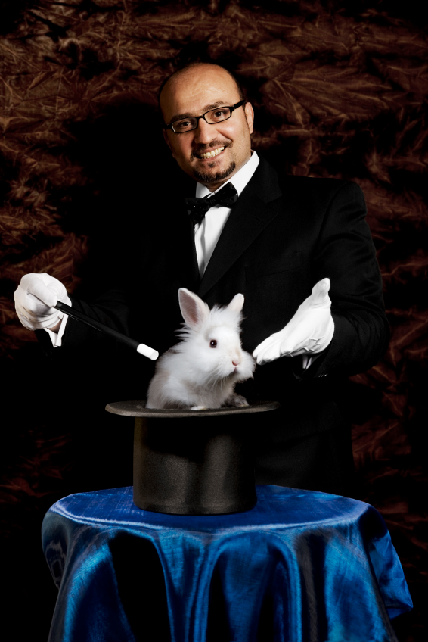
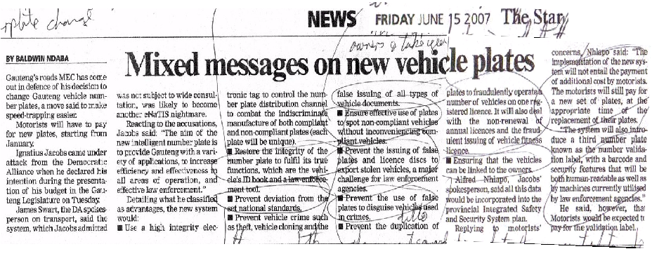
The new Gauteng numberplate with microchip
+
=
“Restore the integrity of the number plate to fulfil its true functions which are the vehicle’s ID book and a law enforcement tool.“
Notes:
Over the years my research led to some useful insights
Do not be mesmerized by technology or hype
Do NOT abdicate your intellect!
PUNCHY

Slide 15
Notes:
WHAT CAUSES IT FAILURE?
Since 1993, analysed in 2003, course, book
Sustainable versus experimentation
People
The factors causing IT failure – in 1993 I became aware of the high failure rate of IT projects and started to talk about it – as a consequence i was asked to investigate many failed or failing projects and to help to turn them around – over the years i built up a large catalogue of the factors causing failure – in 2003 i undertook a critical issues analysis of the factors causing failure and arrived at a list of seven critical factors causing failure together with the critical factors for success which then became the subject of a course and subsequently a book – HOLD UP THE BOOK – since then i have advised many clients and led a number of significant projects and consistently validated the basic analysis
The biggest single factor causing failure is Mythology at 30% followed by lack of executive custody and inappropriate governance at 25%

Slide 16
Factors causing IT failure
Notes:
NB People
KEEP IT SHORT

Slide 17
The value of technology is determined by the person using the technology
Notes:
A gun is neither good nor bad
If it is held by a person you regard as good and pointed at a person you regard as bad the gun is good
BUT if it is pointed at YOU it is always BAD!

Slide 18
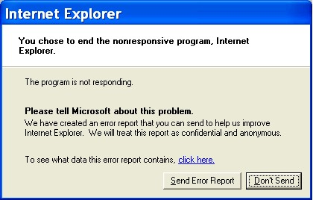
Technology is only 5% of what causes failure
Software defects CAN be prevented
Take a stand
Notes:
A gun is neither good nor bad
If it is held by a person you regard as good and pointed at a person you regard as bad the gun is good
BUT if it is pointed at YOU it is always BAD!

Slide 19
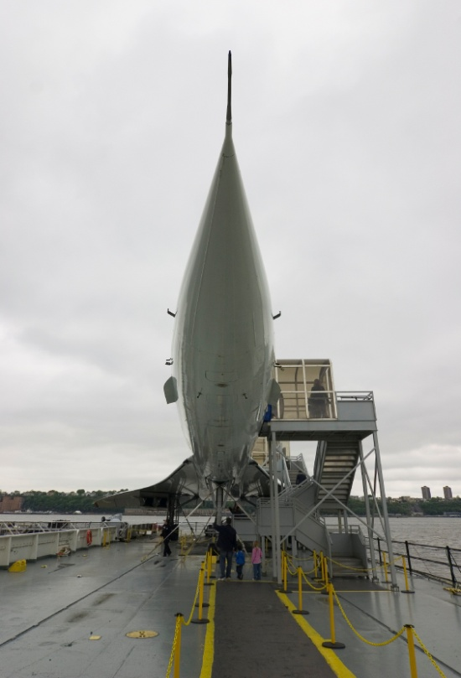
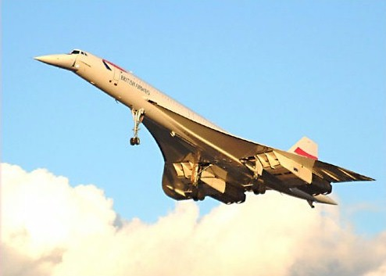
Is IT moving so fast you cannot keep up?
Notes:
You CAN keep up with technology
Make technology slow down to the pace that suits your business
Relevant technology that works
GESTURES
Do you remember the Concorde? – Johannesburg to London in three hours? – BUT the people on the ground were not prepared to tolerate the BOOMMMMMMMMMMM as the plane travelled at supersonic speed so it never took off commercially, only 20 were built and one crashed owing to a design flaw and the last planes today are sitting in museums
Then there was the Boeing 747 – designed almost by accident – tell the story
So, is IT moving so fast – not really – the big question is whether Windows Vista is the Concorde of IT

Slide 20
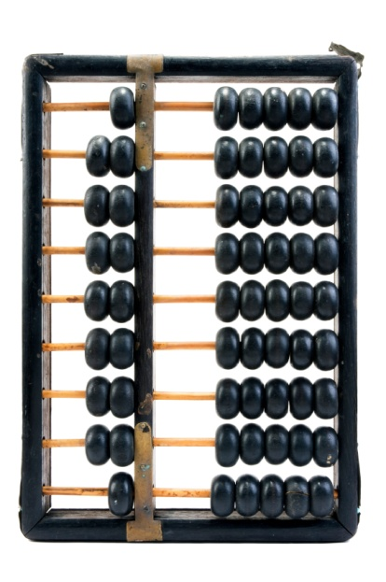
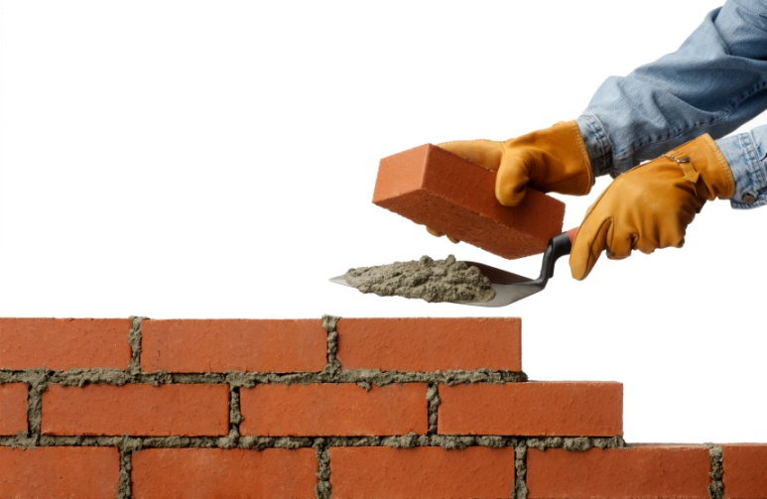
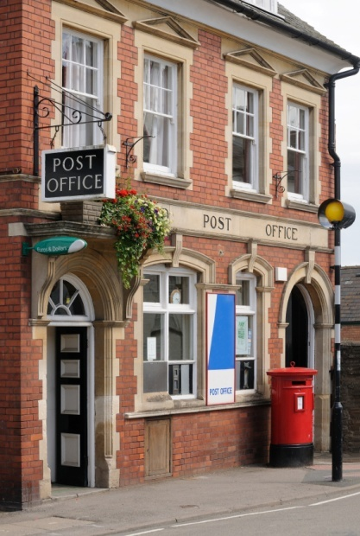
What is IT?
REALLY?
Notes:
You understand the technology well enough to manage it
VERSUS ABDICATION / DISEMPOWERMENT
FAST
Computers are simply adding machines or switches that switch left or right – 0 or 1 – on or off – called binary – they just do things very quickly, everything you see is a pattern of 0’s and 1’s – a very fast Abacus – the content is always the same – binary code -- source code is simply instructions for the bricklayer
Wordprocessors are typewriters -- The typing story – so why do you want to spend thousands of Rands upgrading your typewriter every few years? -- Databases are filing cabinets or warehouses -- General ledgers are large books that book keepers write in – networks are postal systems – large frame pictures cost a lot and take up lots of space

Slide 21
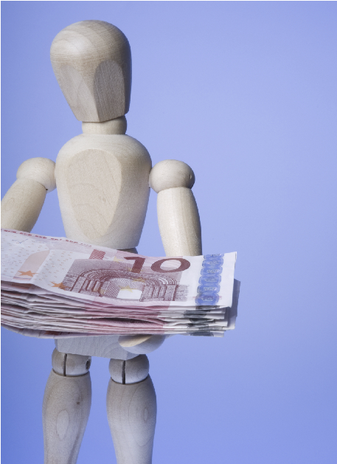
People create value
Notes:
People using technology effectively create value
To do this they MUST be properly trained and informed

Slide 22
Unlocking IT value

Slide 23
Staff
Most elementary business IT skill?
Boots in the mud socialization
Speak business language
Sustainable staffing
The customer is the reason for your day
Clean up your data
“the customer is NOT an interruption of your day the customer is the reason for your day”

Slide 24
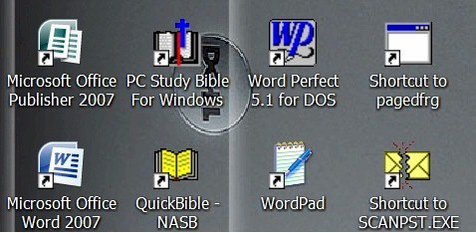
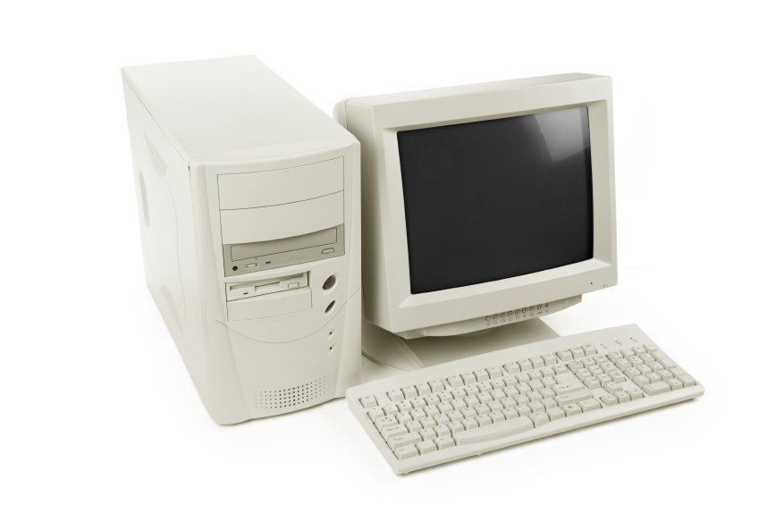
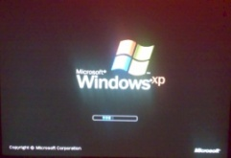
Policy
Hand-me-down principle
Long term partnership (20 years) with business system suppliers
Business focus

Slide 25
Leadership
Executive custody is critical
-- 50% leadership
“Business systems department” instead of “IT department”
Notes:
Make it work
It is all in a name

Slide 26
Strategic alignment
Essence of why the business exists and how it thrives
Model the business in the configuration from a strategic perspective
Data engineering

Slide 27
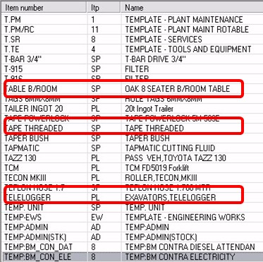
Data – from chaos ...
Notes:
Does your data look like this ...
or like this?

Slide 28
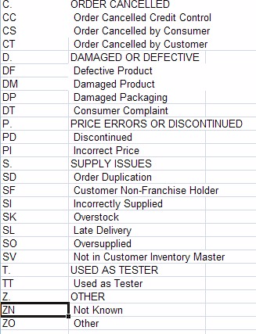
... to order
Example of simple hierarchically structured data table
Notes:
Does your data look like this ...
or like this?

Slide 29
Call to action
Three actions?
Defects are entirely preventable
IT is NOT magic do NOT abdicate your intellect
Design AGAINST failure
You DO understand IT
Slow IT down to your speed!
Align IT with the essence of your business (strategy)
CEO custody and leadership are critical– take charge

Slide 30
If you do not act within 48 hours you probably never will – act TODAY! ☺
James@JamesARobertson.com
Telephone: ++27-(0)83-251-6644

Slide 31
Design IT solutions like bridges ...
To last
Psalm 136:5 "To Him who by wisdom made the heavens, for His mercy endures forever;"

Slide 32
Questions?
Acknowledgement and dedication
Clients, associates and staff
Father and mother Angus and Thelma
Children Alexandra and Struan
Fiona, Sandi, Ingrid, Sandra, Teresa, Helena, Julie and Maria
To the glory of the Eternal Creator
James@JamesARobertson.com
Telephone: ++27-(0)83-251-6644
Finding the missing pieces of your I.T. and strategy puzzles

